Slide 1
Using Bookzilla in Primary School
Lesson one: story flavours Lesson two: story recipes Lesson three: what’s my genre?
scottishbooktrust.com

Slide 2
Bookzilla Lesson one: story flavours
scottishbooktrust.com
Notes:
Lesson 1: Story Flavours
Children can find picking a new book difficult so it is important that they know what genre they enjoy reading. This lesson will teach genre and help all the children in the class fully understand the meaning and how to use it themselves to discuss or select books.
Resources: white boards and markers or paper, timer. Aims: Introduce the meaning of genre and become familiar with the main genres used by Bookzilla. Children will listen to the views of others and contribute their own views in discussion. Children will have the opportunity to consider what they like, why they like it and then talk about this with their talk partner.
Approx. 25mins

Slide 3
Warm up activity
Work with a talk partner. You have three minutes. Write down:
Your three favourite crisp flavours
Your three least favourite crisp flavours
Explain your choices to your partner and be ready to share your lists.
scottishbooktrust.com
Notes:
Warm up activity. With talk partners children list their favourite three flavours of crisp and the three flavours they do not like. Encourage children to explain to each other why they like their favourites and why they don’t like their choice.

Slide 4
Results
Use tally marks to find the most and least popular crisps.
scottishbooktrust.com
Notes:
Groups feed back to the class. Use tally marks to collate results and identify the top and bottom flavours. You can use a white board or paper for this instead of power point. Discuss the results as a class. Is one flavour really liked or disliked, shared preferences, individual tastes etc.

Slide 5
Results: part two
How many different flavours did you like as a class?
Did you agree on the worst flavoured crisps?
With your partner write down as many things as you can that come in different varieties, flavours, kinds, types, tastes or styles. You have three minutes!
scottishbooktrust.com
Notes:
Count the number of different crisps listed by the class. Look for patterns and discuss the results. Does anything stick out? Is there a clear winner and loser?
Before we talk about genre children will be familiar with the concept of variety, types, flavours etc. Children work with talk partners to make a list of items that come in different varieties, e.g. music, ice cream, chocolates, computer games.

Slide 6
Examples of different types and flavours:
Ice cream
Music
Chocolates
Fruit
Video games
scottishbooktrust.com
Notes:
Write down the class suggestions. Support the children with ideas to start them if required. You can use a white board or paper for this instead of power point.

Slide 7
Genre
Books come in different ‘flavours’ too which we call genres.
Genre, noun: a style or category of art, music or literature. How many genres can you and your partner think of? You have three minutes!
scottishbooktrust.com
Notes:
Dictionary definition of genre. Genre, noun: a style or category of art, music, or literature. It may help the children if you add film and computer game genres to this discussion.

Slide 8
Bookzilla
Scottish Book Trust's free reading app developed by young people, for young people.
scottishbooktrust.com
Notes:
Bookzilla is a free app for upper primary and early secondary school students in Scotland. The app encourages pupils to read for pleasure, whether they are already regular readers or just embarking on their reading journey. Young people can receive tailored book recommendations, see what's popular among their classmates and challenge themselves to try something new with a reading dare. The app promotes different featured collections every month.
Watch the Bookzilla App Trailer on the Scottish Book Trust website.

Slide 9
Bookzilla genres
Adventure and Mystery Laugh Out Loud Sport All Things Magical History Poetry Classics
Shelf Help Biographies Scary Stories Discover Facts Family Friends Gaelic Idols
Graphic Novels Environmental Heart Breakers Humans Aren’t Illegal Scots
Your Books as Movies
scottishbooktrust.com
Notes:
Genres used in Bookzilla. Discussion: do children know what they already like?

Slide 10
Bookzilla Lesson two: story recipes
scottishbooktrust.com
Notes:
This lesson can be adapted to the needs of the class. The length of time will vary depending on how far you want to extend the lesson. It can be as short as approx. 25mins up depending on the activities used. This lesson can then be used as the stimulus for a series of story writing lessons. Resources: Print out the Bookzilla genre table, print and cut up the ingredients cards for characters, settings, action and blanks. Print out the story generator board page, there is also a seven types of story list to help support writing plans. This can be one each or one for each talk partner pair. Aim: Using the ingredients and generator board children pick random cards to create the ingredients for a story and then discuss and decide on possible genre. Children will have the opportunity to discuss structure, character and setting. They will be able to talk about aspects of writing with reference to genre. They can then create texts using genre to engage the reader.
Suggestions for different levels of activities:
Use the story ingredient cards and story generator board to create a story idea with your talking partner and identify the genre.
Use your story idea and write a plan for the story.
Draw a story board or cartoon strip.
Write a story from your plan.
Write a blurb for a book based on the story.
Swap one ingredient. Does this change the genre?
Develop your ideas and write a class collection of stories.

Slide 11
Recipes and genres
Different ingredients can be mixed together to make different flavours of cake. For example: a chocolate cake needs chocolate, a carrot cake needs grated carrots.
Different elements can be mixed together to make different genres of books. For example: putting a dragon, a wizard, or magic into a story will probably make it a fantasy book!
scottishbooktrust.com
Notes:
Discuss some ingredients for example, chocolate in a chocolate cake, carrot cake etc. Talk about how recipes are written, ingredients then method. We are going to use this to come up with story ideas.

Slide 12
Can you guess the genre?
talking dog | classroom | maths test | laugh out loud
prince | sweet heart | royal ball | heart breakers
wild animals | jungle | earth quake | natural world
robot | space ship | meteor storm | Sci-fi
bats | castle ruins | storm | scary stories
missing boy | School camp | police investigation | mystery
Notes:
Guess the genre from the characters, settings and events. Could it be more than one genre? Children should have the list of Bookilla genres to help them.
Click on the tile to reveal the genre.

Slide 13
Make a story
Use the following ingredients to come up with the idea of a story. You have five minutes! Main character: A giant dog Friend: A magical witch Enemy: An evil monster Setting: A ruined castle Action: A snow storm
scottishbooktrust.com
Notes:
Print and cut out the story ingredient cards for use by the pupils on the story generator board.

Slide 14
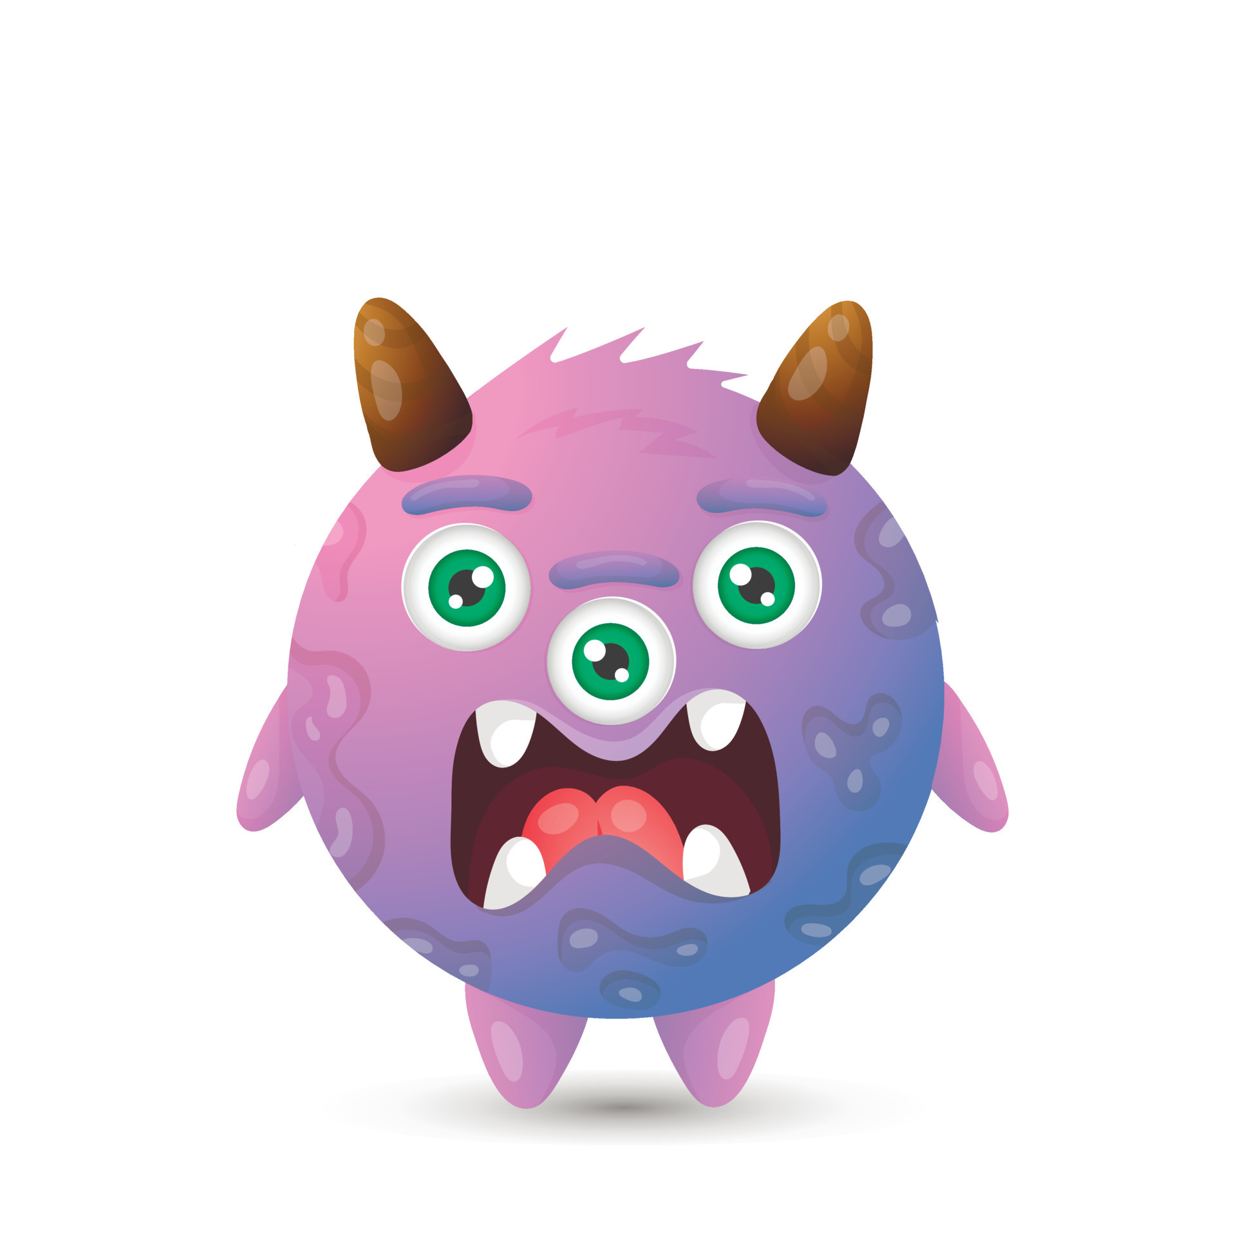
Make a story: part two
Sometimes small changes make a big difference on a genre! Is this still a scary story? Main character: A giant dog Friend: A magical witch Enemy: An evil monster Setting: A school Action: A lorry spill of custard
scottishbooktrust.com
Notes:
Here two of the ingredients have been changed. The setting and the action. How does that change the potential for story direction and genre? Give children time with their talk partners to come up with scary and funny story lines. Use this in a way to suit your class. With talking partners plan stories. Develop these stories further or leave them as plans. Individual work on story plans to suit class needs.

Slide 15
Seven types of story
It’s often said there’s seven types of story. Can you think of a film, book or fairy tale for each of these examples?
Overcoming the monster or beating the baddie
Getting the treasure or rags to riches
Quest
Journey
Comedy
Tragedy
Rebirth
scottishbooktrust.com
Notes:
Use the seven types of story to help children create an outline for their story. These are some possible examples of familiar titles that fit types:
Overcoming the monster or beating the baddie – Snow White
Getting the treasure or rags to riches - Cinderella
Quest – The Lord of the Rings
Journey – The Lion King
Comedy – Despicable Me
Tragedy - Frozen
Rebirth - Beauty and the Beast

Slide 16
Bookzilla Lesson three: what’s my genre?
scottishbooktrust.com
Notes:
Lesson 3: What’s my genre?
Resources: paper, pens
Aims: This short lesson reviews genre and what we have learned. Children should be able to skim and scan short texts or blurbs the identify genre. Children will select texts with confidence and explain their own personal preferences.
Approx. 20 minutes

Slide 17
Bookzilla genres: part two
Adventure and Mystery Laugh Out Loud Sport All Things Magical History Poetry Classics
Shelf Help Biographies Scary Stories Discover Facts Family Friends Gaelic Idols
Graphic Novels Environmental Heart Breakers Humans Aren’t Illegal Scots
Your Books as Movies
scottishbooktrust.com
Notes:
Can children explain what genres they already like? Give children time with talk partners to talk about their preferences. Encourage them to talk about films, computer games and write notes on genre as well as their titles.

Slide 18
Fortune tellers
Use your fortune teller to help find your genre!
Pick one of the four story settings on the first four options.
Using the number beside your chosen setting, open and close your fortune teller that many times and then pick one of the next four options.
If you do not like the any of them, pick a number and move again.
Pick an option you like and open it to reveal a Bookzilla genre to try!
scottishbooktrust.com
Notes:
Print the Genre Fortune Teller on the website (one per child) and use the WikiHow guide to fold them: https://www.wikihow.com/Fold-a-Fortune-Teller
Children can colour it in to personalise it. Follow the instructions on the slide – whichever options the children pick should lead them to a genre to try. They can then use the Bookzilla app to look for some books under that genre.

Slide 19
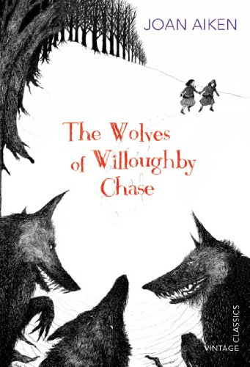
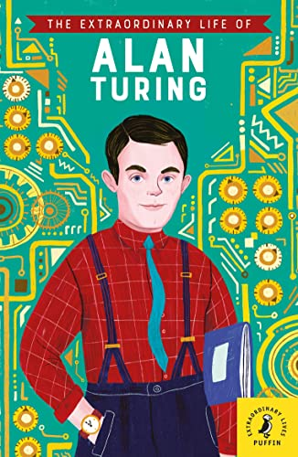
History, Adventure and Mystery, Biography
Can you guess the genre?
Book cover examples: part one
scottishbooktrust.com
Notes:
Can you guess the genre from the cover? Talk about how the cover can help us decide what the book is going to be like. Some books can be in two genres and that is okay, there is just more to like. Use the blurbs to help decide on genre if required. The Wolves of Willoughby Chase: Adventure and mystery The Extraordinary Life of Alan Turing: Biographies
Horrible Histories Scotland: History, Laugh out Loud

Slide 20
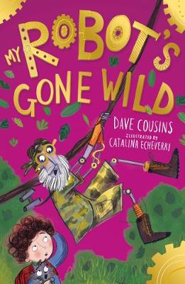
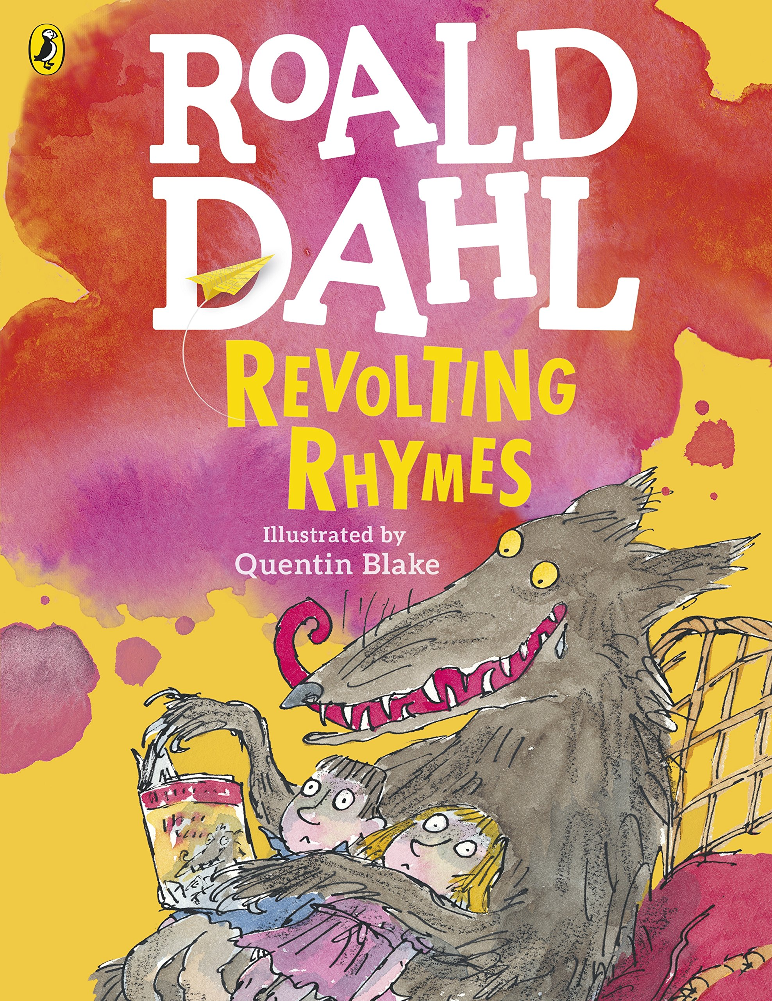
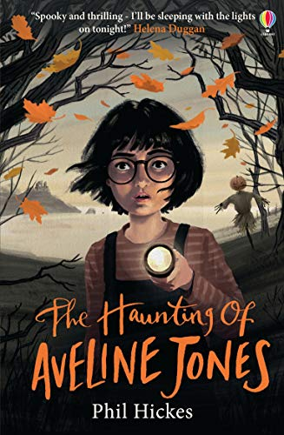
Book cover examples: part two
Can you guess the genre?
Scary Stories, Poetry, Laugh out Loud
scottishbooktrust.com
Notes:
Mr. Robot’s Gone Wild: Laugh out loud Revolting Rhymes: Poetry The Haunting of Avaline Jones: Scary Stories

Slide 21
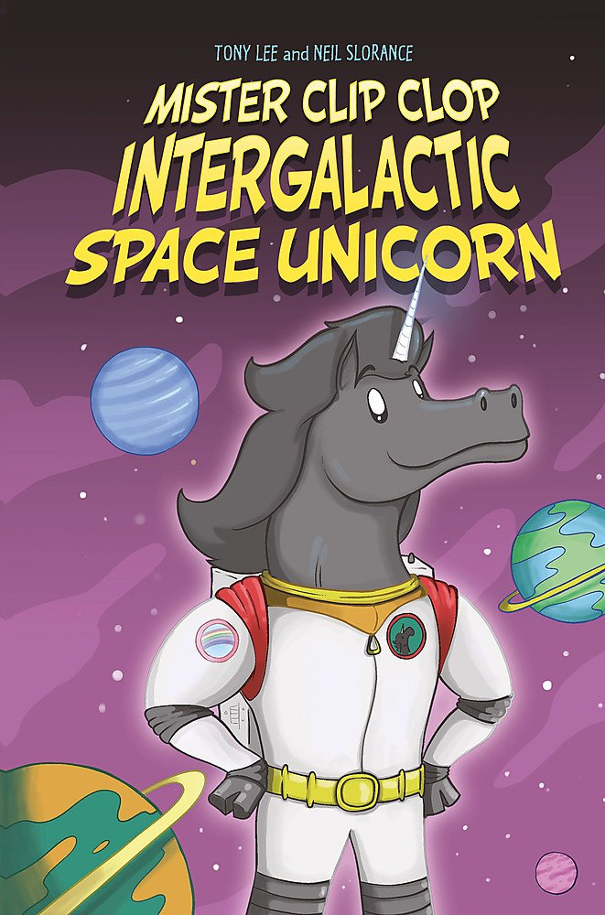
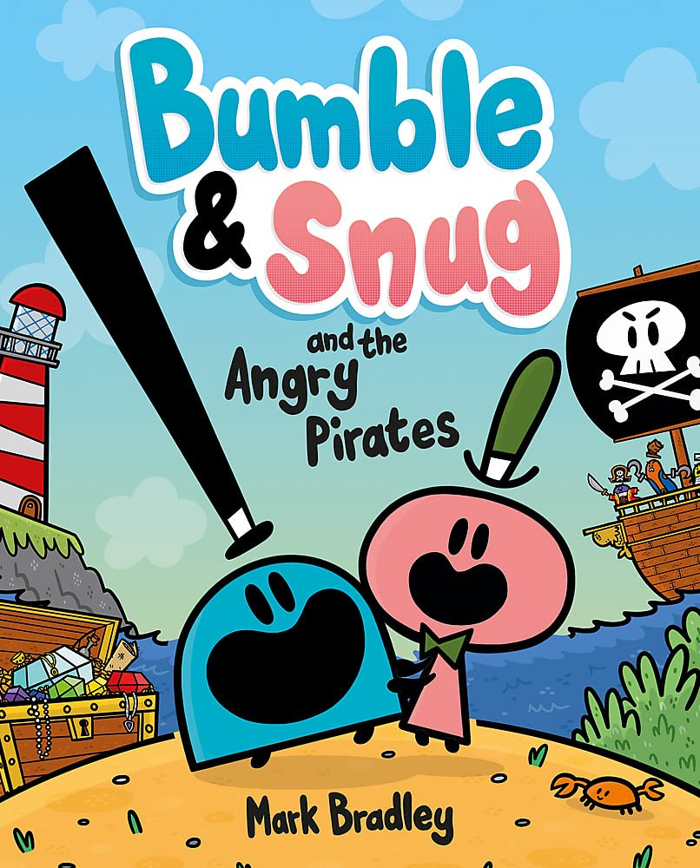
Book cover examples: part three
Can you guess the genre?
Shelf Help, Graphic Novels, Sci-Fi
scottishbooktrust.com
Notes:
Mister Clip Clop Intergalatic Space Unicorn: Sci-Fi Boost Your Brain: Shelf Help Bumble & Snug and the Angry Pirates: Comics and graphic novels, Laugh out Loud

Slide 22
Book blurb examples: part one
Can you guess the genre?
Book 1: Emily Windsnap lives on a boat, but her mother has always been oddly anxious to keep her out of the water. It is only when Emily has her first school swimming lesson that she discovers why: as soon as she gets into the water, she grows a tail! Soon Emily discovers a glorious underwater world of fishes, coral, shipwrecks and mermaids, and, best of all, she finds a best friend! With mermaid Shona Silkfin by her side, Emily uncovers a surprising family secret and embarks on a quest to reunite her mum and dad.
scottishbooktrust.com
Notes:
The Tail of Emily Windsnap: All Things Magical

Slide 23
Book blurb examples: part two
Can you guess the genre?
Book 2: Emmy is brilliant at the computer game, Illusory Isles. Her avatar is a powerful fire elemental with magma claws and flaming breath. Life at school is the exact opposite. Emmy is friendless and bullied by Vanessa AKA the Queen of Mean. To Vanessa and her gang, Emmy is a weirdo with bad handwriting, horrible fashion sense and no dad. But if Emmy can take on the Mulch Queen online, perhaps she can also find a way to take on Vanessa too? Emmy decides to level up and solve this challenge alone.
scottishbooktrust.com
Notes:
Emmy Levels Up: Friends and Family

Slide 24
Book blurb examples: part three
Can you guess the genre?
Book 3: Bert loves playing football. He dreams of being a professional footballer for his local side West Farthing F.C. There is just one problem. Bert is a chicken. Bert lives on Manor Side Farm where the other chickens make fun of him for being different – a chicken should not play football, they say – but despite this, it is still Bert's dream. After a chance visit to the farm by Gerald Fox, the manager of West Farthing F.C., Bert is talent spotted and offered a try out. Gerald wants Bert to be their secret weapon in an upcoming game. . .
scottishbooktrust.com
Notes:
Fowl: Sport, Laugh Out Loud

Slide 25
Genre guessing
What genres did you like the most?
Which covers were easiest to guess?
Which blurbs were easiest to guess?
Is it easier to guess from a cover or a blurb?
scottishbooktrust.com
Notes:
Have a discussion about genres. Extension Ideas: Create a graph of everyone in the classroom’s favourite genre
Make a display of different genres
Organise your class library by different genres
Make genre stickers or labels for classroom books
Make your own fortune tellers to help you decide your next read
Make a genre challenge – pick 5 genres and try and read a book from each one

Slide 26
Thank you
scottishbooktrust.com
Scottish Book Trust is a national charity changing lives through reading and writing. Registered company SC184248 | Scottish charity SC027669

