Slide 1
How to use this PowerPoint
This is the first of four lessons from Brian Conaghan on creative writing for young people. You can find the rest via the Scottish Book Trust website:
Lesson 1: Developing your writing skills
Lesson 2: Developing your writing style
Lesson 3: How to write with empathy
Lesson 4: Developing your editing skills
Each PowerPoint shares tips that can be used throughout a pupil’s writing experience, as well as activities you can do in your class or library. Where possible, we have highlighted how long an activity takes. Please do adapt this based upon the pupils you work with and/or if you would like to add in some time for reflection. Feel free to use this entire PowerPoint as one lesson, or to dip in and out and use some of the tips and activities.
scottishbooktrust.com

Slide 2
Curriculum for Excellence
Activity 1: Experiment with tone LIT 3-20a/4-20a, LIT 3-23a/4-23a, LIT 3-26a/4-26a, ENG 3-27a/4-27a, ENG 3-31a/4-31a
Activity 2: Create varied sentences LIT 3-16a/4-16a, ENG 3-17a/4-17a, ENG 3-19a/4-19a, LIT 3-20a/4-20a Activity 3: Rewrite for tone LIT 3-20a/4-20a, LIT 3-24a/4-24a, ENG 3-27a/4-27a
scottishbooktrust.com

Slide 3
Reading Schools
If you are taking part in Reading Schools, using this resource could help you deliver the following key areas of the framework:
2.2.2 Interdisciplinary book projects
2.3.4 Opportunities for learners to respond to what they’re reading
scottishbooktrust.com

Slide 4
Brian Conaghan’s creative writing lessons
Lesson 2: Developing your writing style
scottishbooktrust.com

Slide 5
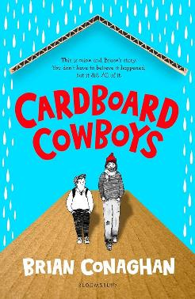
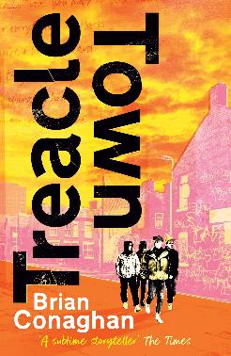
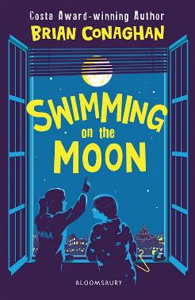
Introduction
Hello, I’m Brian Conaghan and, among other things, I’m an author (you can see some of my books below!) as well as a Reading Schools ambassador. These lessons gather some of my advice and ideas for developing your creative writing. This time we’ll be looking at developing your own style including under playing with different sentence structures, tones and what is unique to you!
scottishbooktrust.com

Slide 6
Tip 1: Find your voice
Your style of a writer often comes from voice – how you naturally express yourself. Try to write as you speak, without trying to sound like anyone else. Over time, your authentic voice will emerge.
Try this Try writing a diary – you don’t have to show it to anyone! It’ll help you gather what your voice sounds like when you’re not writing “for” anyone.
scottishbooktrust.com

Slide 7
Activity 1: Experiment with tone (1)
30+ minutes
Experiment with some different tones. Write four scenes, each with one of the following tones:
Humorous
Serious
Conversational
Formal
If you need some prompts for your different scenes, see the next slide.
scottishbooktrust.com

Slide 8
Activity 1: Experiment with tone (2)
30+ minutes
Scene idea 1 Your character is sleeping overnight in a haunted house. Scene idea 2 Your character receives a phone call that changes everything they thought they knew.
Scene idea 3 Your character goes back to a place they haven’t visited in a long time.
Scene idea 4
Your character has been selected as one of the first people to land on a strange alien planet.
scottishbooktrust.com

Slide 9
Activity 1: Experiment with tone (3)
30+ minutes
Reflect When you write, notice what you find comfortable. If you don’t like writing (for example) a funny story, then don’t try and force lots of jokes. If you find serious topics really stifling, think about where you can find opportunities for humour. Talk to a partner. Which tone was the hardest to write?
scottishbooktrust.com

Slide 10
Tip 2: Play with sentence structure (1)
Your style can be shaped by the types of sentences you use. For example, very short sentences will have high impact. Long sentences will have more of a flow.
Finding a rhythm between the two can help you create your own distinctive style.
scottishbooktrust.com

Slide 11
Tip 2: Play with sentence structure (2)
Example 1: Short and punchy sentences for impact He ran. Faster. Heart pounding. The door slammed behind him. What impact does this have on you? Discuss.
scottishbooktrust.com

Slide 12
Tip 2: Play with sentence structure (3)
Example 1: Short and punchy sentences for impact He ran. Faster. Heart pounding. The door slammed behind him. Effect:
A sense of urgency
Tension
Fast-paced
Intense
scottishbooktrust.com

Slide 13
Tip 2: Play with sentence structure (4)
Example 2: Long, flowing sentences for rhythm The sun was beginning to sink low on the horizon, casting long, golden shadows across the fields, and in the distance, the faint chirping of crickets could be heard as the cool evening breeze stirred the leaves.
What impact does this have on you? Discuss.
scottishbooktrust.com

Slide 14
Tip 2: Play with sentence structure (5)
Example 2: Long, flowing sentences for rhythm The sun was beginning to sink low on the horizon, casting long, golden shadows across the fields, and in the distance, the faint chirping of crickets could be heard as the cool evening breeze stirred the leaves.
Effect:
Calm
Reflective
Good for creating atmosphere
Slows down the narrative
scottishbooktrust.com

Slide 15
Tip 2: Play with sentence structure (6)
Example 3: Mixing sentence lengths for variety She stood there, unsure. The street was quiet, too quiet, as though the world had stopped breathing for a moment. Then, with a deep breath, she took a step forward.
What impact does this have on you? Discuss.
scottishbooktrust.com

Slide 16
Tip 2: Play with sentence structure (7)
Example 3: Mixing sentence lengths for variety She stood there, unsure. The street was quiet, too quiet, as though the world had stopped breathing for a moment. Then, with a deep breath, she took a step forward.
Effect:
Keeps the reader engaged
Balances tension and reaction
Dynamic
scottishbooktrust.com

Slide 17
Activity 2: Create varied sentences
20 minutes
Try and create one of each:
A paragraph of short punchy sentences
A paragraph of long, flowing sentences
A paragraph that mixes the sentence lengths
Swap with a partner and see which they prefer.
scottishbooktrust.com

Slide 18
Tip 3: Write outside your comfort zone
Try writing outside of what you normally do — whether it’s a new genre or an unusual character voice.
Pushing boundaries helps you discover new elements of style.
scottishbooktrust.com

Slide 19
Activity 3: Rewrite for tone
20 minutes
Take a serious scene and rewrite it with a humorous or lighthearted tone, or vice versa. This can reveal new dimensions of your story and characters.
scottishbooktrust.com

Slide 20
Tip 4: Be consistent
While it’s important to experiment, consistency in tone, voice, and pacing across a piece helps solidify a writer’s style.
By careful editing of your work this will maintain a consistent style, even when trying new things.
scottishbooktrust.com

Slide 21
Recap
You have your own unique voice and style which you can develop by experimenting with tone and structure
Writing outside your comfort zone can help you develop as a writer, and discover different themes or emotions in your writing
Use varied sentence structure to create engaging writing
scottishbooktrust.com

Slide 22
Next steps
Watch Brian Conaghan’s Authors Live
See our other Creative writing resources
Use the Young Writers section of the website for more advice, plus articles and top tips from other authors
scottishbooktrust.com

Slide 23
Thank you
scottishbooktrust.com
Scottish Book Trust is a national charity changing lives through reading and writing. Registered company SC184248 | Scottish charity SC027669

