Slide 1
How to use this PowerPoint
This is the first of four lessons from Brian Conaghan on creative writing for young people. You can find the rest via the Scottish Book Trust website:
Lesson 1: Developing your writing skills
Lesson 2: Developing your writing style
Lesson 3: How to write with empathy
Lesson 4: Developing your editing skills
Each PowerPoint shares tips that can be used throughout a pupil’s writing experience, as well as activities you can do in your class or library. Where possible, we have highlighted how long an activity takes. Please do adapt this based upon the pupils you work with and/or if you would like to add in some time for reflection. Feel free to use this entire PowerPoint as one lesson, or to dip in and out and use some of the tips and activities.
scottishbooktrust.com

Slide 2
Curriculum for Excellence
Activity 1: Spot the technique LIT 3-16a/4-16a, ENG 3-17a/4-17a, LIT 3-18a/4-18a, ENG 3-19a/4-19a
Activity 2: Free writing LIT 3-20a/4-20a, LIT 3-21a/4-21a, LIT 3-25a/4-25a, LIT 3-28a/4-28a Activity 3: Outlining LIT 3-25a/4-25a, LIT 3-26a/4-26a, LIT 3-28a/4-28a
Activity 4: Spot the errors LIT 3-21a/4-21a, LIT 3-22a/4-22a, LIT 3-23a/4-23a
Activity 5: Swap and edit ENG 3-19a/4-19a, LIT 3-23a/4-23a, LIT 3-24a/4-24a
Activity 6: Two versions LIT 3-26/4-26a, ENG 3-27a/4-27a, LIT 3-29a/4-29a
scottishbooktrust.com

Slide 3
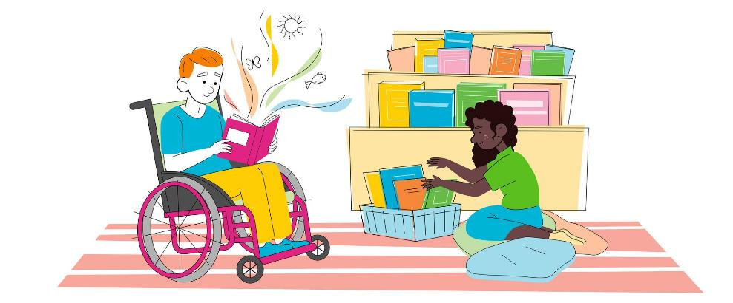
Reading Schools
If you are taking part in Reading Schools, using this resource could help you deliver the following key areas of the framework:
2.2.2 Interdisciplinary book projects
2.3.4 Opportunities for learners to respond to what they’re reading
scottishbooktrust.com

Slide 4
Brian Conaghan’s creative writing lessons
Lesson 1: Developing your writing skills
scottishbooktrust.com

Slide 5
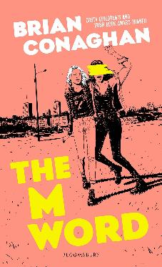
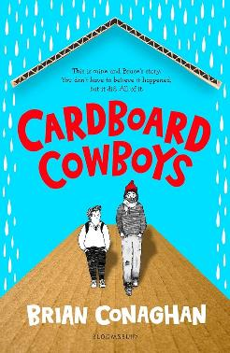
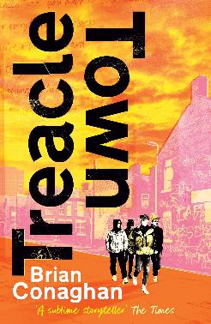
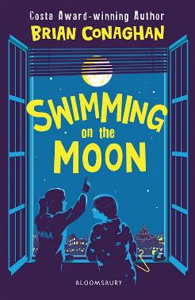
Introduction
Hello, I’m Brian Conaghan and, among other things, I’m an author (you can see some of my books below!) as well as a Reading Schools ambassador. These lessons gather some of my advice and ideas for developing your creative writing. This time we’ll be looking at writing skills including generating ideas, creating a structure and thinking about your audience.
scottishbooktrust.com

Slide 6
Tip 1: Read regularly
If you want to write, then reading regularly is one of the best things you can do. It will:
Expand your vocabulary
Improve understanding of sentence structure
Expose you to different writing styles
Try this Next time you’re in a library or bookshop, try and read a new genre you wouldn’t normally read.
scottishbooktrust.com

Slide 7
Activity 1: Spot the technique
15 minutes
Read a short passage and identify the key writing techniques being used. These could include:
Metaphor or simile
Personification
Motif
Repetition
Alliteration
Onomatopoeia
See BBC Bitesize’s guide to Literary techniques if you need any definitions!
scottishbooktrust.com
Notes:
Link to BBC Bitesize Literary techniques webpage: https://www.bbc.co.uk/bitesize/guides/z839dmn/revision/2

Slide 8
Tip 2: Practice freewriting
Freewriting is a practice where you set a timer and write for the entire time. The main thing is to keep you pen moving.
Encourages creativity
Reduces writer’s block
Helps generate ideas without self-editing
Try this Even if you only have 3 minutes, freewriting is a great way to make some time to get ideas on the page!
scottishbooktrust.com

Slide 9
Activity 2: Freewriting
10 minutes
Spend 10 minutes freewriting on any topic. Don’t stop to edit, just let the ideas flow. Once you’ve finished, go through and highlight any ideas or phrases you like. You can use these as a title for your next piece or come back to them later next time you write!
scottishbooktrust.com
Notes:
Link to BBC Bitesize Literary techniques webpage: https://www.bbc.co.uk/bitesize/guides/z839dmn/revision/2

Slide 10
Tip 3: Outline your ideas
Outlining your ideas before writing can take a lot of forms. You can use bullet points, headings or notes to plan where you think your writing will go. Creating an outline will:
Help you organise your thoughts
Improve clarity in your writing
Prevent your writer’s block by giving you a structure to go back to
scottishbooktrust.com

Slide 11
Activity 3: Outlining
15 minutes
Come up with an outline for a short story or an essay from start to end.
Exposition: introduce characters/setting
Inciting incident: something happens that sets the story in motion
Rising action: Build excitement. What happens next?
Climax: The turning point, moment of greatest suspense or action
Falling action: What happens after the climax? What’s the consequence?
Resolution: End of the story, problems are resolved
scottishbooktrust.com

Slide 12
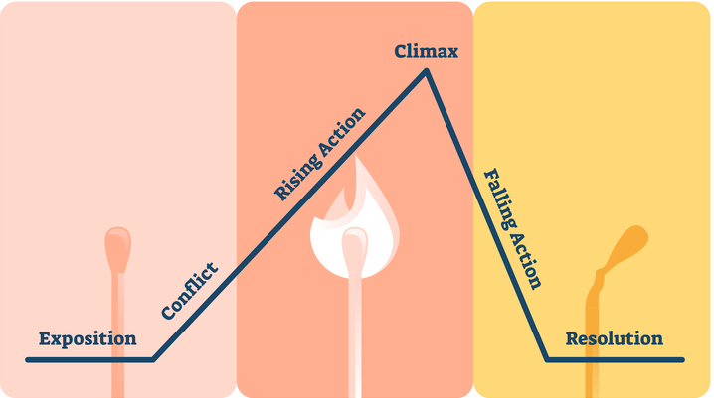
Activity 3: Outlining (2)
15 minutes
You could map your story onto a map, like this one:
Image from Backstage.com
scottishbooktrust.com

Slide 13
Tip 4: Check for grammar and style!
Checking for grammar in style is and important part of writing. Once you’ve got a first draft, always proofread. Doing this will:
Improve your writing’s readability
Help you avoid common mistakes
Strengthens your writing skills
scottishbooktrust.com

Slide 14
Activity 4: Spot the errors (1)
5 minutes
Well, its another rainy day. I wonder what I will do? First, I think I’ll take a walk around the neyborhood to stretch my legs. Second I’ll cook a big breakfast with toast fruit eggs and bacon. After that, I might mow my lawn: it’s getting pretty long. I’m not sure what I’ll do after that. I guess I should go see mom, I think she wanted me to go shopping with her. I have no idea why she can’t just go by her self. Or better still she could ask my dad to go with her! I doubt he will want to go with her though. He doesn’t like going to the shops as much as I do!
Sample paragraph taken from English For Everyone
scottishbooktrust.com
Notes:
Sample paragraph taken from: https://englishforeveryone.org/

Slide 15
Activity 4: Spot the errors (2)
5 minutes
Well, it’s another rainy day. I wonder what I will do. First, I think I’ll take a walk around the neighbourhood to stretch my legs. Second, I’ll cook a big breakfast with toast, fruit, eggs and bacon. After that, I might mow my lawn; it’s getting pretty long. I’m not sure what I’ll do after that. I guess I should go see my mum. I think she wants me to go shopping with her. I have no idea why she can’t just go by herself. Or, better still, she could ask my dad to go with her! I doubt he will want to go with her though. He dislikes going to the shops as much as I do!
Sample paragraph taken from English For Everyone
scottishbooktrust.com
Notes:
Sample paragraph taken from: https://englishforeveryone.org/

Slide 16
Tip 5: Edit and revise
Going back to something you’ve written and editing it is a great way to improve your work. Editing:
Refines ideas
Enhances clarity and coherence
Polishes your language and tone
scottishbooktrust.com

Slide 17
Activity 5: Swap and edit
20 minutes
Swap your story with someone else and edit each others’ work.
Take a note of:
Any mistakes
Anything you’re not sure you understand
Anything you really like
Swap back and share your feedback!
scottishbooktrust.com

Slide 18
Tip 6: Try writing for different audiences
Writing for different audiences will necessarily require you to understand different styles of writing. It will also help you:
Adapt to different tones and styles
Understand audience expectations
Engage readers effectively
scottishbooktrust.com

Slide 19
Activity 6: Two versions
30+ minutes
Write two flash fictions: one for an adult reader, and one for a child reader.
Notice:
How do you keep attention for the different audiences?
What is different between word choice or style?
scottishbooktrust.com

Slide 20
Recap
Reading regularly will help you develop as a wrier
Freewriting is a great way to get past writer’s block and generate new ideas
Creating an outline can help you develop a structure
Always edit, revise and check your work
Play around with different formats and types
Next time we’ll look at developing your own unique voice and style.
scottishbooktrust.com

Slide 21
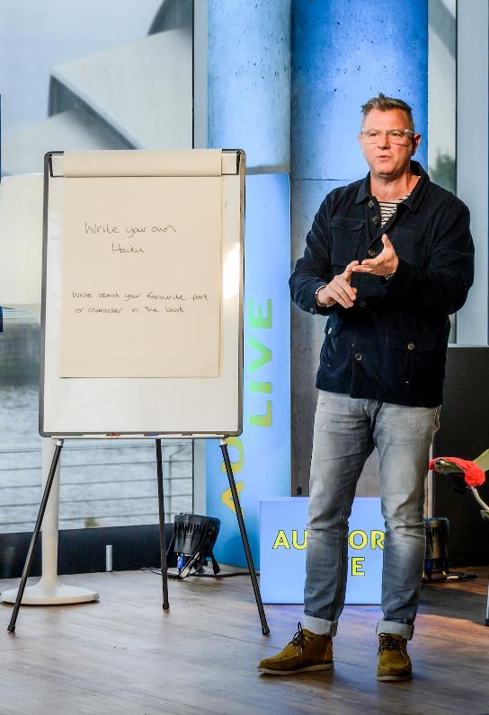
Next steps
Watch Brian Conaghan’s Authors Live
See our other Creative writing resources
Use the Young Writers section of the website for more advice, plus articles and top tips from other authors
scottishbooktrust.com

Slide 22
Thank you
scottishbooktrust.com
Scottish Book Trust is a national charity changing lives through reading and writing. Registered company SC184248 | Scottish charity SC027669

